Slide 1
API Design: “REST assured…
it’s not that hard”

Slide 2
But… why?

Slide 3


But… why?
In the beginning, the server did everything.
request

Slide 4

But… why?
In the beginning, the server did everything.
Do stuff
request

Slide 5
But… why?
In the beginning, the server did everything.
Do stuff
request
show result

Slide 6
But… why?
In the beginning, the server did everything.
ask for an action
Do stuff
request
show result
rendered
template

Slide 7

And then…
But… why?
In the beginning, the server did everything.
ask for an action
Do stuff
request
show result
rendered
template

Slide 8

And then…
But… why?
In the beginning, the server did everything.
ask for an action
Do stuff
request
show result
rendered
template

Slide 9
And then…
But… why?
In the beginning, the server did everything.
<XML/>
ask for an action
Do stuff
request
show result
rendered
template

Slide 10
SOAP
And then…
But… why?
In the beginning, the server did everything.
<XML/>
ask for an action
Do stuff
request
show result
rendered
template

Slide 11

SOAP
And then…
But… why?
In the beginning, the server did everything.
<XML/>
ask for an action
Do stuff
request
show result
rendered
template

Slide 12


Slide 13




Slide 14


Slide 15


Slide 16



Slide 17
ask for an action
Do stuff
request
show result
rendered
template

Slide 18
request data
data
render it yourself…

Slide 19
request data
data
render it yourself…

Slide 20

request data
data
render it yourself…

Slide 21
API Values
Coupling
Chattiness
Client Complexity
Server Complexity
Cognitive Complexity
Discoverability
Versioning

Slide 22
API Values
Coupling
Chattiness
Client Complexity
Server Complexity
Cognitive Complexity
Discoverability
Versioning

Slide 23
API Values
Coupling
Chattiness
Client Complexity
Server Complexity
Cognitive Complexity
Discoverability
Versioning

Slide 24
API Values
Coupling
Chattiness
Client Complexity
Server Complexity
Cognitive Complexity
Discoverability
Versioning

Slide 25
API Values
Coupling
Chattiness
Client Complexity
Server Complexity
Cognitive Complexity
Discoverability
Versioning

Slide 26
API Values
Coupling
Chattiness
Client Complexity
Server Complexity
Cognitive Complexity
Discoverability
Versioning

Slide 27
API Values
Coupling
Chattiness
Client Complexity
Server Complexity
Cognitive Complexity
Discoverability
Versioning

Slide 28
API Values
Coupling
Chattiness
Client Complexity
Server Complexity
Cognitive Complexity
Discoverability
Versioning

Slide 29
API Values
RPC
REST
GraphQL
Coupling
Chattiness
Client Complexity
Server Complexity
Cognitive Complexity
Discoverability
Versioning

Slide 30
API Values
RPC
REST
GraphQL
Coupling
Chattiness
Client Complexity
Server Complexity
Cognitive Complexity
Discoverability
Versioning

Slide 31
RPC

Slide 32
Remote Procedural
Call
heyYouDoSomething()
doSomething()
result

Slide 33

Remote Procedural
Call
“Call a function in a remote
server”
Unit: Function
heyYouDoSomething()
doSomething()
result

Slide 34
Remote Procedural
Call
“Call a function in a remote
server”
Unit: Function
Examples (chat app):
listConversations();
listMessages(int conversationId);
sendMessage(int conversationId, string body);
heyYouDoSomething()
doSomething()
result

Slide 35

Remote Procedural
Call
listRecentConversations()
doSomething()
result

Slide 36
Remote Procedural
Call
“Call a function in a remote
server”
Unit: Function
Examples (chat app):
listConversations();
listMessages(int conversationId);
sendMessage(int conversationId, string body);
listRecentConversations();
heyYouDoSomething()
doSomething()
result

Slide 37
Remote Procedural
Call
PROs
Simple and easy to understand
Lightweight payloads
High performance
listRecentConversations()
doSomething()
result

Slide 38
Remote Procedural
Call
CONs
Tight coupling
No discoverability
Function explosion
listRecentConversations()
doSomething()
result

Slide 39
Remote Procedural
Call
State of the art:
gRPC, Thirft, Twirp
Use Cases:
Command oriented API (ie. slack)
Microservices (lightweight calls)
listRecentConversations()
doSomething()
result

Slide 40
REST

Slide 41
REST
(not a standard, just an architectural style)

Slide 42
Representational
State
Transfer
GET https://api.example.io/stuff
Resources
{stuff}

Slide 43
Representational
State
Transfer
“Here are some resources and
what you can do with them.”
Unit: Resource
GET https://api.example.io/stuff
Resources
{stuff}

Slide 44
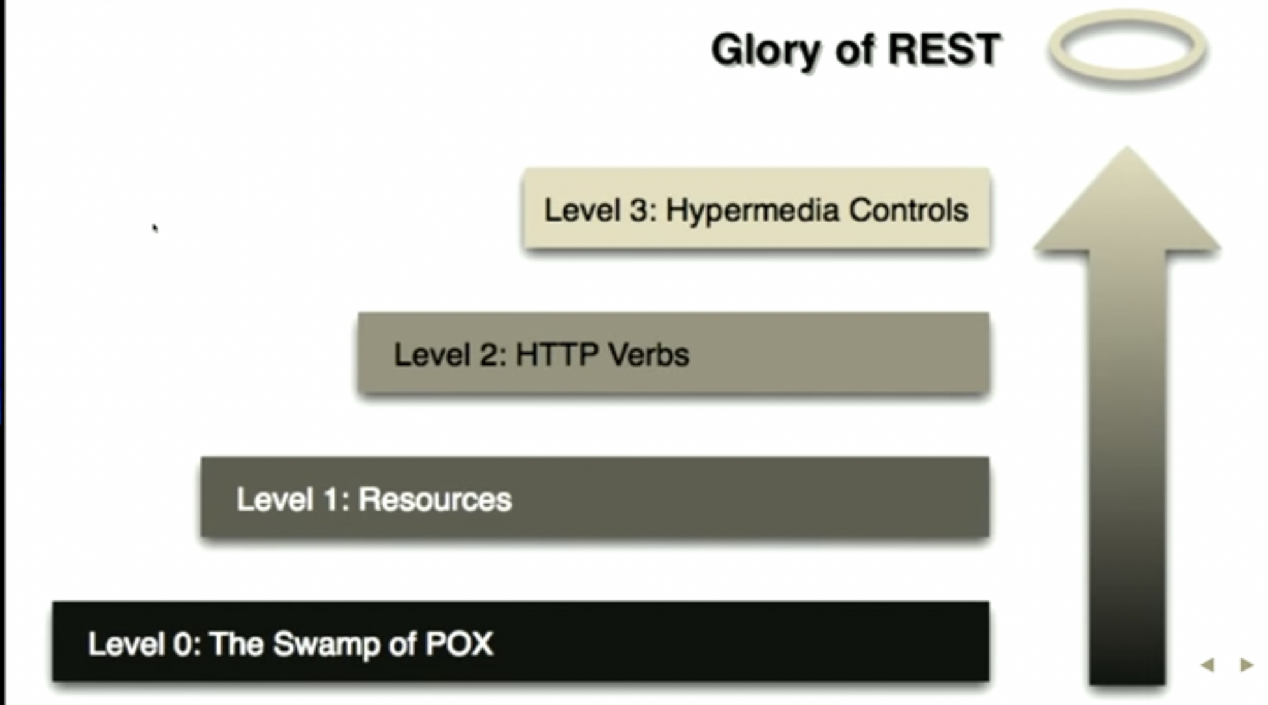
Representational
State
Transfer
Source: https://youtu.be/vgm_uGmspMI
“A no nonsense GraphQL and REST comparison by Phil Sturgeon”

Slide 45
Representational
State
Transfer
Source: https://youtu.be/vgm_uGmspMI
not REST at all
“A no nonsense GraphQL and REST comparison by Phil Sturgeon”

Slide 46
Plain
Old
XML
It was commonly used as a transport for RPC.
SOAP tried to fix it but overcomplicated everything.

Slide 47
Representational
State
Transfer
RESTish
Source: https://youtu.be/vgm_uGmspMI
not REST at all
“A no nonsense GraphQL and REST comparison by Phil Sturgeon”

Slide 48
Resources (JSON)
GET https://api.example.io/conversations
{
“count”: 2,
“value”: [
{
“id”: 2,
“title”: “IDE vs VIM”,
“messages”: [
{
“body”: “VIM is obviously better!”,
“author”: “name”: “AnyVIMUser”
}
]
},
. . .
]
}

Slide 49
Resources (JSON)
GET https://api.example.io/conversations
REST != JSON over HTTP
{
“count”: 2,
“value”: [
{
“id”: 2,
“title”: “IDE vs VIM”,
“messages”: [
{
“body”: “VIM is obviously better!”,
“author”: “name”: “AnyVIMUser”
}
]
},
. . .
]
}

Slide 50
Resources
REST leverages HTTP in several ways:
Verbs:
POST → CREATE
GET → READ
PUT → REPLACE
PATCH -> PARTIAL REPLACE
DELETE → uhm… DELETE
Caching
Proxies
ETC…
GET https://api.example.io/conversations
REST != JSON over HTTP
{
“count”: 2,
“value”: [
{
“id”: 2,
“title”: “IDE vs VIM”,
“messages”: [
{
“body”: “VIM is obviously better!”,
“author”: “name”: “AnyVIMUser”
}
]
},
. . .
]
}

Slide 51
Resources (RESTish)
GET https://api.example.io/conversations
{
“count”: 2,
“value”: [
{
“href”: “https://api.example.io/conversations/2”,
“title”: “IDE vs VIM”,
“messages”: “https://api.example.io/conversations/2/messages”,
“author”: “https://api.example.io/users/1008”
},
. . .
]
}

Slide 52
Resources (RESTish)
Endpoint names are nouns (plural)
GET https://api.example.io/conversations
{
“count”: 2,
“value”: [
{
“href”: “https://api.example.io/conversations/2”,
“title”: “IDE vs VIM”,
“messages”: “https://api.example.io/conversations/2/messages”,
“author”: “https://api.example.io/users/1008”
},
. . .
]
}

Slide 53
Resources (RESTish)
GET https://api.example.io/conversations
Resource relationships
(each resource accessible by it’s link)
{
“count”: 2,
“value”: [
{
“href”: “https://api.example.io/conversations/2”,
“title”: “IDE vs VIM”,
“messages”: “https://api.example.io/conversations/2/messages”,
“author”: “https://api.example.io/users/1008”
},
. . .
]
}

Slide 54
Resources (RESTish)
GET https://api.example.io/conversations
Links are usually endpoint/id
And will retrieve the details of that
resource
{
“count”: 2,
“value”: [
{
“href”: “https://api.example.io/conversations/2”,
“title”: “IDE vs VIM”,
“messages”: “https://api.example.io/conversations/2/messages”,
“author”: “https://api.example.io/users/1008”
},
. . .
]
}

Slide 55
Resources (RESTish)
RESTish (common useful patterns)
a POST request to https://api.example.io/conversations/2/messages will CREATE a new message (usually) generating all unique artifacts server side. Two identical requests WILL create 2 different resources.
GET https://api.example.io/conversations
But can also be endpoint/slug
{
“count”: 2,
“value”: [
{
”slug”: “ide-vs-vim”,
“href”: “https://api.example.io/conversations/ide-vs-vim”,
“title”: “IDE vs VIM”,
“messages”: “https://api.example.io/conversations/2/messages”,
“author”: “https://api.example.io/users/1008”
},
. . .
]
}

Slide 56
Resources (RESTish)
RESTish (common useful patterns)
a POST request to https://api.example.io/conversations/2/messages will CREATE a new message (usually) generating all unique artifacts server side. Two identical requests WILL create 2 different resources.
a PUT request to https://api.example.io/payments/1234-1234-1234 will update the status of payment 1234-1234-1234. It might create the resource if it doesn’t exist (depends on business rules). Integrity of data is a client responsibility, sometimes avoiding the possibility of duplicate commands.
GET https://api.example.io/conversations
But can also be endpoint/slug
{
“count”: 2,
“value”: [
{
”slug”: “ide-vs-vim”,
“href”: “https://api.example.io/conversations/ide-vs-vim”,
“title”: “IDE vs VIM”,
“messages”: “https://api.example.io/conversations/2/messages”,
“author”: “https://api.example.io/users/1008”
},
. . .
]
}

Slide 57
Resources (RESTish)
RESTish (common useful patterns)
a POST request to https://api.example.io/conversations/2/messages will CREATE a new message (usually) generating all unique artifacts server side. Two identical requests WILL create 2 different resources.
a PUT request to https://api.example.io/payments/1234-1234-1234 will update the status of payment 1234-1234-1234. It might create the resource if it doesn’t exist (depends on business rules). Integrity of data is a client responsibility, sometimes avoiding the possibility of duplicate commands.
GET will never generate side effects.
GET https://api.example.io/conversations
But can also be endpoint/slug
{
“count”: 2,
“value”: [
{
”slug”: “ide-vs-vim”,
“href”: “https://api.example.io/conversations/ide-vs-vim”,
“title”: “IDE vs VIM”,
“messages”: “https://api.example.io/conversations/2/messages”,
“author”: “https://api.example.io/users/1008”
},
. . .
]
}

Slide 58
Resources (RESTish)
RESTish (common useful patterns)
a POST request to https://api.example.io/conversations/2/messages will CREATE a new message (usually) generating all unique artifacts server side. Two identical requests WILL create 2 different resources.
a PUT request to https://api.example.io/payments/1234-1234-1234 will update the status of payment 1234-1234-1234. It might create the resource if it doesn’t exist (depends on business rules). Integrity of data is a client responsibility, sometimes avoiding the possibility of duplicate commands.
GET will never generate side effects.
PUT is idempotent but PATCH might not be.
Example: PATCH https://api.example.io/users/1
{
”change”: “name”,
“from”: “Chepe”,
”to”: “Jose”
}
GET https://api.example.io/conversations
But can also be endpoint/slug
{
“count”: 2,
“value”: [
{
”slug”: “ide-vs-vim”,
“href”: “https://api.example.io/conversations/ide-vs-vim”,
“title”: “IDE vs VIM”,
“messages”: “https://api.example.io/conversations/2/messages”,
“author”: “https://api.example.io/users/1008”
},
. . .
]
}

Slide 59
Representational
State
Transfer
“Here are some resources and
what you can do with them.”
Unit: Resource
GET https://api.example.io/conversations
Resources
{stuff}
Recent Conversations Sidebar!

Slide 60
Representational
State
Transfer
“Here are some resources and
what you can do with them.”
Unit: Resource
GET https://api.example.io/conversations
GET https://api.example.io/conversations/2
GET https://api.example.io/users/1008
GET https://api.example.io/conversations/4
GET https://api.example.io/users/1012
Resources
{stuff}
Recent Conversations Sidebar!

Slide 61
Representational
State
Transfer
Only this is REST
RESTish
Source: https://youtu.be/vgm_uGmspMI
not REST at all
“A no nonsense GraphQL and REST comparison by Phil Sturgeon”

Slide 62
Controls (HATEOAS)
GET https://api.example.io/conversations/2
{
“parent”: “https://api.example.io/conversations”,
“href”: “https://api.example.io/conversations/2”,
“title”: “IDE vs VIM”,
“messages”: “https://api.example.io/conversations/2/messages”,
“author”: “https://api.example.io/users/1008”
“actions”:{
“create”:{
“method”: “POST”,
“href”: “https://api.example.io/conversations/2/messages”,
“description”: “Reply to a conversation.”,
“example”:
{
“text”: “your reply”,
}
}
}
}

Slide 63
Controls (HATEOAS)
Hypertext As The Engine Of Application State
GET https://api.example.io/conversations
{
“count”: 2,
“value”: [
{
“href”: “https://api.example.io/conversations/2”,
“title”: “IDE vs VIM”,
“messages”: “https://api.example.io/conversations/2/messages”,
“author”: “https://api.example.io/users/1008”
},
. . .
]
}

Slide 64
Controls (HATEOAS)
Hypertext As The Engine Of Application State
GET https://api.example.io/conversations
{
“count”: 2,
“value”: [
{
“href”: “https://api.example.io/conversations/2”,
“title”: “IDE vs VIM”,
“messages”: “https://api.example.io/conversations/2/messages”,
“author”: “https://api.example.io/users/1008”
},
. . .
]
}

Slide 65
Controls (HATEOAS)
GET https://api.example.io/conversations/2
{
“parent”: “https://api.example.io/conversations”,
“href”: “https://api.example.io/conversations/2”,
“title”: “IDE vs VIM”,
“messages”: “https://api.example.io/conversations/2/messages”,
“author”: “https://api.example.io/users/1008”
“actions”:{
“create”:{
“method”: “POST”,
“href”: “https://api.example.io/conversations/2/messages”,
“description”: “Reply to a conversation.”,
“value”:
{
“text”: “Your reply here…”,
}
}
}
}
The server tells the client
how to interact with each resource.

Slide 66
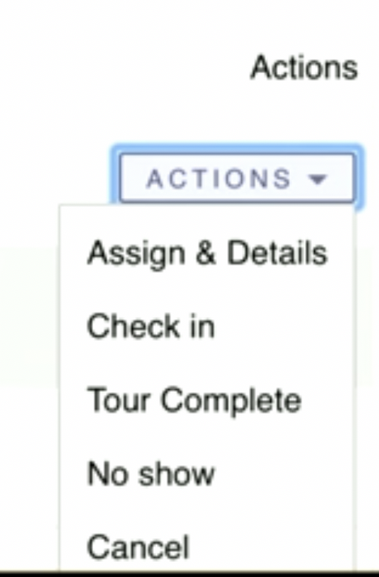
Controls (HATEOAS)
The client now can create “Actions”
Dropdowns dynamically!
- Someone pitching HATEOAS, maybe
GET https://api.example.io/conversations/2
{
“parent”: “https://api.example.io/conversations”,
“href”: “https://api.example.io/conversations/2”,
“title”: “IDE vs VIM”,
“messages”: “https://api.example.io/conversations/2/messages”,
“author”: “https://api.example.io/users/1008”
“actions”:{
“create”:{
“method”: “POST”,
“href”: “https://api.example.io/conversations/2/messages”,
“description”: “Reply to a conversation.”,
“value”:
{
“text”: “Your reply here…”,
}
}
}
}
The server tells the client
how to interact with each resource.

Slide 67
Controls (HATEOAS)
GET https://api.example.io/conversations/2
Better discoverability
{
“parent”: “https://api.example.io/conversations”,
“href”: “https://api.example.io/conversations/2”,
“title”: “IDE vs VIM”,
“messages”: “https://api.example.io/conversations/2/messages”,
“author”: “https://api.example.io/users/1008”
“actions”:{
“create”:{
“method”: “POST”,
“href”: “https://api.example.io/conversations/2/messages”,
“description”: “Reply to a conversation.”,
“value”:
{
“text”: “Your reply here…”,
}
}
}
}

Slide 68
Controls (HATEOAS)
GET https://api.example.io
Not a list of resources,
but an entrypoint.
{
“conversations”: {
“href”: https://api.example.io/conversations,
“rel”: [“collection”],
“description”: “View all conversations”
},
“messages”: {
“href”: https://api.example.io/messages,
“rel”: [“collection”],
“description”: “View all messages”
},
}

Slide 69

Controls (HATEOAS)
GET https://api.example.io
Not a list of resources,
but an entrypoint.
{
“conversations”: {
“href”: https://api.example.io/conversations,
“rel”: [“collection”],
“description”: “View all conversations”
},
“messages”: {
“href”: https://api.example.io/messages,
“rel”: [“collection”],
“description”: “View all messages”
},
}

Slide 70
Controls (HATEOAS)
PROs
Decoupled client and server.
API can evolve over time.
Leverages HTTP.
GET https://api.example.io/conversations/2
Better discoverability
{
“parent”: “https://api.example.io/conversations”,
“href”: “https://api.example.io/conversations/2”,
“title”: “IDE vs VIM”,
“messages”: “https://api.example.io/conversations/2/messages”,
“author”: “https://api.example.io/users/1008”
“actions”:{
“create”:{
“method”: “POST”,
“href”: “https://api.example.io/conversations/2/messages”,
“description”: “Reply to a conversation.”,
“value”:
{
“text”: “Your reply here…”,
}
}
}
}

Slide 71
Controls (HATEOAS)
CONs
Widely misunderstood and misused.
No single spec (but look ad siren, HAL & json-api).
Big payloads and chattiness.
GET https://api.example.io/conversations/2
Better discoverability
{
“parent”: “https://api.example.io/conversations”,
“href”: “https://api.example.io/conversations/2”,
“title”: “IDE vs VIM”,
“messages”: “https://api.example.io/conversations/2/messages”,
“author”: “https://api.example.io/users/1008”
“actions”:{
“create”:{
“method”: “POST”,
“href”: “https://api.example.io/conversations/2/messages”,
“description”: “Reply to a conversation.”,
“value”:
{
“text”: “Your reply here…”,
}
}
}
}

Slide 72
Controls (HATEOAS)
CONs
Widely misunderstood and misused.
No single spec (but look ad siren, HAL & json-api).
Big payloads and chattiness.
GET https://api.example.io/conversations/2
Better discoverability
{
“parent”: “https://api.example.io/conversations”,
“href”: “https://api.example.io/conversations/2”,
“title”: “IDE vs VIM”,
“messages”: “https://api.example.io/conversations/2/messages”,
“author”: “https://api.example.io/users/1008”
“actions”:{
“create”:{
“method”: “POST”,
“href”: “https://api.example.io/conversations/2/messages”,
“description”: “Reply to a conversation.”,
“value”:
{
“text”: “Your reply here…”,
}
}
}
}
Take a look at GraphQL

Slide 73
Controls (HATEOAS)
Killer Use Case:
Management API
Focus on resources (entities).
Multiple varied clients.
Discoverability & documentation.
GET https://api.example.io/conversations/2
Better discoverability
{
“parent”: “https://api.example.io/conversations”,
“href”: “https://api.example.io/conversations/2”,
“title”: “IDE vs VIM”,
“messages”: “https://api.example.io/conversations/2/messages”,
“author”: “https://api.example.io/users/1008”
“actions”:{
“create”:{
“method”: “POST”,
“href”: “https://api.example.io/conversations/2/messages”,
“description”: “Reply to a conversation.”,
“value”:
{
“text”: “Your reply here…”,
}
}
}
}

Slide 74
Resources:
APIs you won’t hate - https://apisyouwonthate.com/
"A no nonsense GraphQL and REST comparison" by Phil Sturgeon - https://youtu.be/vgm_uGmspMI
API Throwdown: RPC vs REST vs GraphQL by Nate Barbettini – https://youtu.be/IvsANO0qZEg

